Slide 1
CAPSTONE PROJECT
Mental Health Screening and Support
Presented By:
Student Name: Praveenkumar D(2021305518)
College Name: Alagappa College of Technology, ANNA UNIVERSITY
Department: B.Tech INDUSTRIAL BIOTECHNOLOGY

Slide 2
OUTLINE
Problem Statement
Proposed System/Solution
System Development Approach
Algorithm & Deployment
Result
Conclusion
Future Scope
References

Slide 3
PROBLEM STATEMENT
Despite increasing awareness of mental health issues, many individuals still face barriers to accessing adequate screening and support services. Existing screening tools may lack accuracy or cultural sensitivity, leading to under identification of mental health concerns. Additionally, support programs may not be readily available or may not effectively address the diverse needs of individuals experiencing mental health challenges. This creates a significant gap in mental health care delivery, contributing to untreated conditions, decreased quality of life, and potential long-term consequences for individuals and communities. Therefore, there is a pressing need to develop and implement comprehensive mental health screening and support initiatives that are accessible, accurate, and tailored to the diverse needs of the population, to promote early intervention and improve mental health outcomes.

Slide 4
PROPOSED SOLUTION
The program should handle various scenarios such as:-
Easy-to-use screening tools adaptable to different situations and cultures.
Accessible screening through online platforms, mobile apps, and community centers.
Personalized support plans based on individual needs.
Crisis intervention protocols for immediate assistance.
Cultural sensitivity training for staff.
Community engagement to reduce stigma.
Continuous evaluation and improvement.
Key Features:
Easy access to screening tools.
Personalized support plans.
Crisis intervention protocols.
Cultural sensitivity training for staff.
Community engagement initiatives.
Continuous program evaluation for improvement.

Slide 5
SYSTEM APPROACH
Technologies Used:
Backend Development: Python
Frontend Interface: Tkinter or PyQt
Database Management: SQLite or MySQL
Version Control and Collaboration: GitHub
Centralized Platform: A single platform manages screening, support, and data.
Web and Mobile Apps: User-friendly apps for screening and support access.
Cloud Infrastructure: Scalable, flexible, and accessible system.
Data Analytics: Analyse results and track program effectiveness.
Secure Communication: Encrypted channels for confidentiality.
AI Integration: Personalized recommendations and risk assessment.
Telehealth Solutions: Remote counselling and support sessions.
Blockchain Technology: Secure data storage and sharing.
Geospatial Mapping: Targeted community engagement efforts.
User Feedback: Continuous improvement based on user input.

Slide 6
ALGORITHM & DEPLOYMENT
Algorithm:
Mental Health Screening Algorithm:
Utilize machine learning algorithms such as logistic regression, decision trees, or support vector machines to analyze screening responses. These algorithms can classify individuals into different risk categories based on their responses to screening questions.
Train the algorithm using labeled data, where each instance is associated with a known mental health outcome (e.g., presence or absence of a specific disorder).
Validate the algorithm's performance using techniques such as cross-validation to ensure its accuracy and generalizability.
Personalized Support Algorithm:
Develop algorithms to match individuals with appropriate support resources and interventions based on their screening results and preferences.
Use techniques such as recommendation systems to suggest relevant resources, support groups, or treatment options tailored to everyone's needs and preferences.
Consider factors such as demographic information, symptom severity, past treatment history, and cultural background when generating personalized support plans.

Slide 7
ALGORITHM & DEPLOYMENT
Deployment:
Backend Deployment:
Choose a cloud platform such as Heroku, AWS (Amazon Web Services), or Google Cloud Platform for deploying your Python backend application. These platforms provide scalable and managed environments for hosting web applications.
Containerize your backend application using Docker to ensure consistency and portability across different environments.
Use container orchestration tools like Kubernetes to automate deployment, scaling, and management of your backend services.
Database Deployment:
Set up and configure your chosen database management system (e.g., SQLite or MySQL). Consider using managed database services offered by cloud providers for easier setup and maintenance.
Ensure proper data backup and recovery mechanisms are in place to prevent data loss and ensure data integrity.

Slide 8
ALGORITHM & DEPLOYMENT
3.Frontend Deployment:
For desktop applications built with Tkinter, package your application using tools like PyInstaller or cx_Freeze to create standalone executables. Distribute these executables to users for installation on their local machines.
For web-based frontends built with PyQt, deploy your frontend alongside your backend on the chosen hosting platform. Utilize static file hosting services or content delivery networks (CDNs) for serving static assets such as HTML, CSS, and JavaScript files.
4.Version Control and Collaboration:
Utilize Git for version control and host our project repository on GitHub. This allows for efficient collaboration among team members, version tracking, and code review.
Implement CI/CD (Continuous Integration/Continuous Deployment) pipelines using tools like GitHub Actions or Jenkins to automate testing, building, and deployment processes, ensuring smooth and reliable software delivery

Slide 9
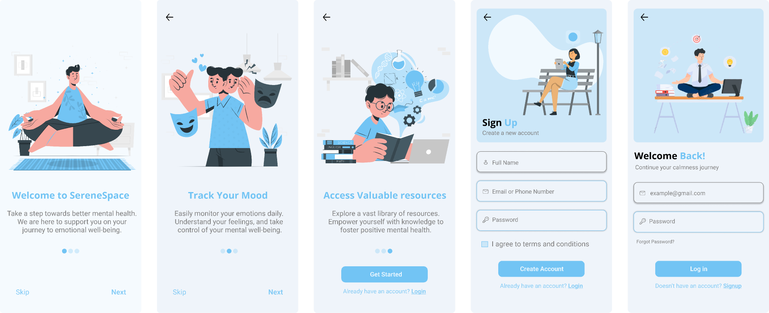
RESULT
1
2
3

Slide 10
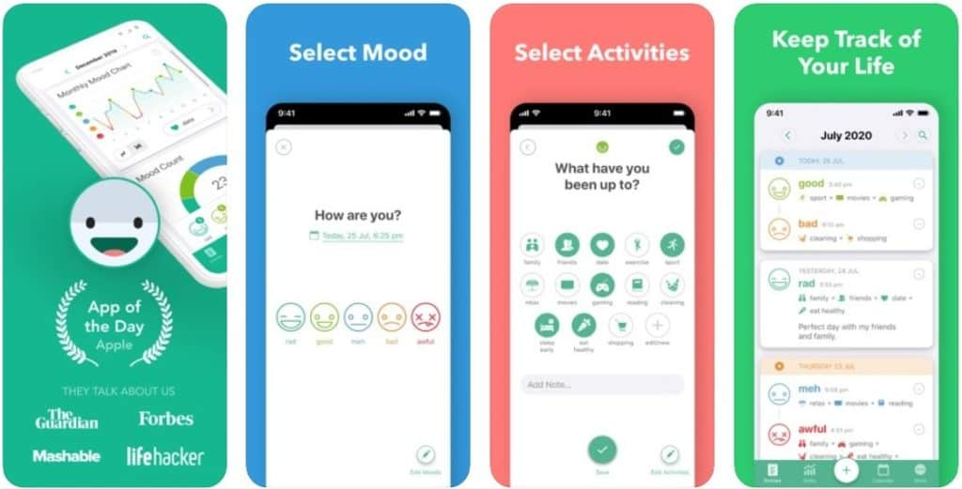
RESULT
7
5
4
6

Slide 11
CONCLUSION
In conclusion, the development of a mental health screening and support system requires a systematic approach encompassing algorithm design and deployment strategies. Leveraging machine learning algorithms for screening and personalized support algorithms ensures accurate assessments and tailored interventions for individuals. For deployment, cloud platforms provide scalable infrastructure for hosting backend services, while containerization and orchestration technologies streamline deployment processes. Additionally, proper database setup and frontend deployment methods ensure data management and user accessibility. By adopting version control and collaboration tools like GitHub, teams can effectively manage project iterations and foster collaboration. Overall, integrating these components facilitates the creation of a robust and accessible system to address mental health needs within communities.

Slide 12
FUTURE SCOPE
Improved Screening Algorithms: Research will lead to better algorithms using more data sources for accurate screening.
Personalized Interventions: Algorithms will create tailored interventions based on individual preferences and real-time data.
Telemedicine Integration: Telemedicine will expand mental health services, especially in remote areas.
Wearable Devices: Wearables will monitor mental health indicators for proactive interventions.
Blockchain Security: Blockchain will ensure secure data sharing for confidentiality.
AR/VR Solutions: AR and VR will provide immersive therapy experiences.
Community Programs: More community-based initiatives will reduce stigma and provide support.
AI Analytics: AI will offer insights and predictions for early intervention and resource allocation.
Global Collaboration: Collaboration will share knowledge and adapt interventions to diverse contexts.
Policy Advocacy: Advocacy efforts will prioritize mental health funding and reduce stigma.

Slide 13
REFERENCES
Alavi N, et al. Feasibility and Efficacy of Delivering Cognitive Behavioral Therapy Through an Online Psychotherapy Tool for Depression: Protocol for a Randomized Controlled Trial. JMIR Res. Protoc. 2021;10:e27489. doi: 10.2196/27489.
Mental Health: Culture, Race, and Ethnicity: Executive Summary: a Supplement to Mental Health: a Report of the Surgeon General. (2001).
https://www.ncbi.nlm.nih.gov/pmc/articles/PMC9420101/
https://github.com/aid4mh/gSCAP
Dataset: www.kaggle.com

Slide 14
THANK YOU…

